Slide 1
CSE291-C00 Machine Learning On Geometry Data

Slide 2
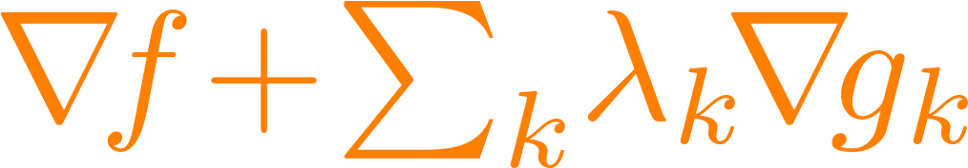
Numerical Tools for Geometry

Slide 3
Motivation
Numerical problems abound
in modern geometry applications.
Quick summary!
Mostly for common ground: You may already know this material.
First half is important; remainder summarizes interesting recent tools.

Slide 4
Two Roles
Client Which optimization tool is relevant?
Designer Can I design an algorithm for this problem?

Slide 5
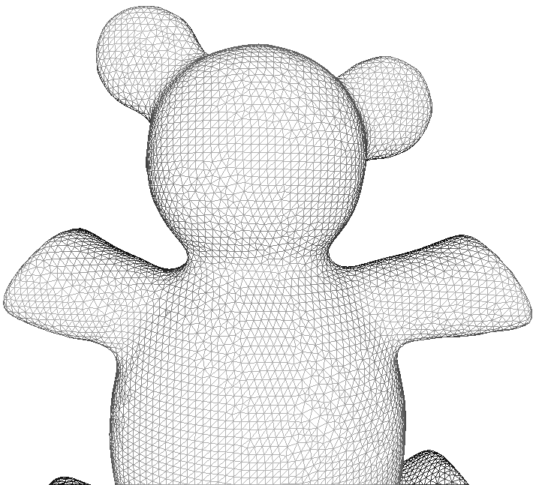
Our Bias
Patterns, algorithms, & examples common in geometry.
Numerical analysis is a huge field.

Slide 6
Rough Plan
Linear problems
Unconstrained optimization
Equality-constrained optimization
Variational problems

Slide 7
Rough Plan
Linear problems
Unconstrained optimization
Equality-constrained optimization
Variational problems

Slide 8
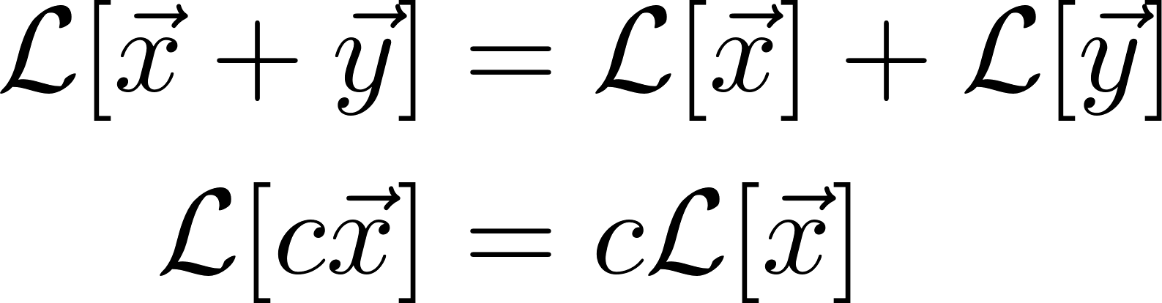
Vector Spaces and Linear Operators

Slide 9
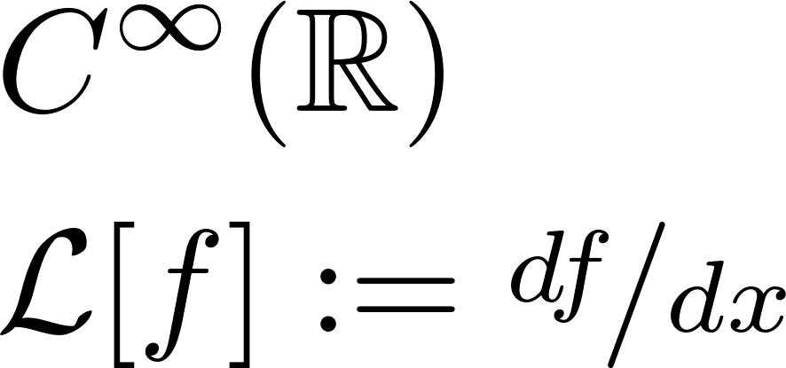
Abstract Example
Eigenvectors?

Slide 10
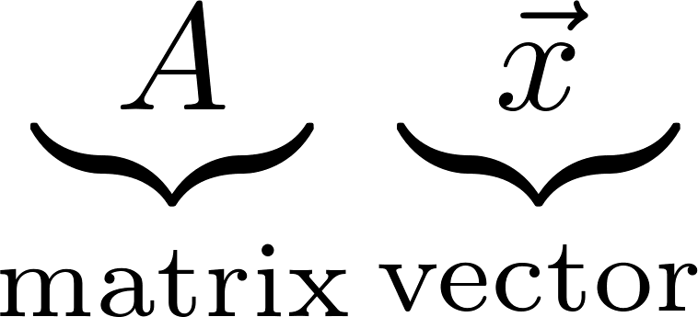
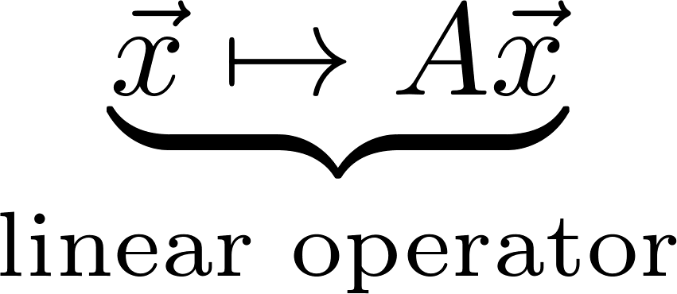
In Finite Dimensions

Slide 11
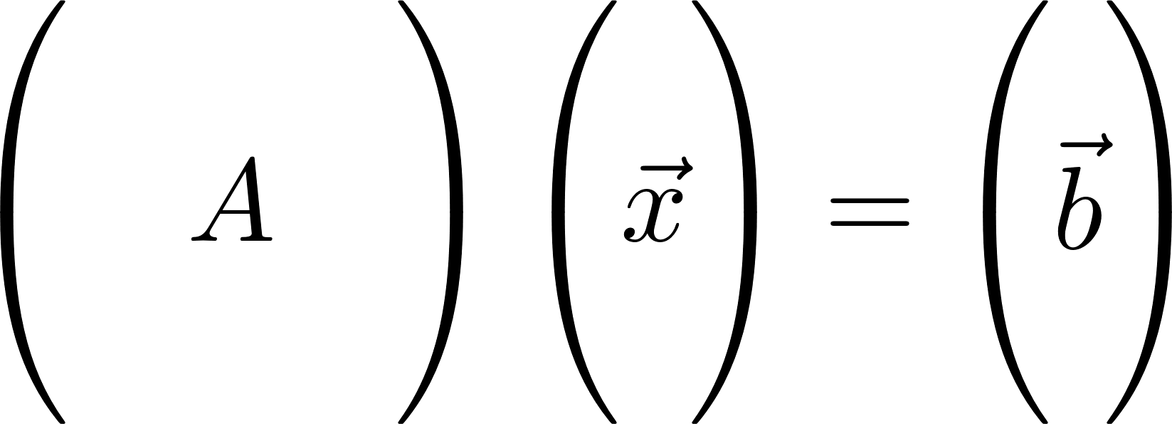
Linear System of Equations
Simple “inverse problem”

Slide 12
Common Strategies
Gaussian elimination
O(n³) time to solve Ax=b or to invert
But: Inversion is unstable and slower!
Never ever compute A⁻¹ if you can avoid it.

Slide 13
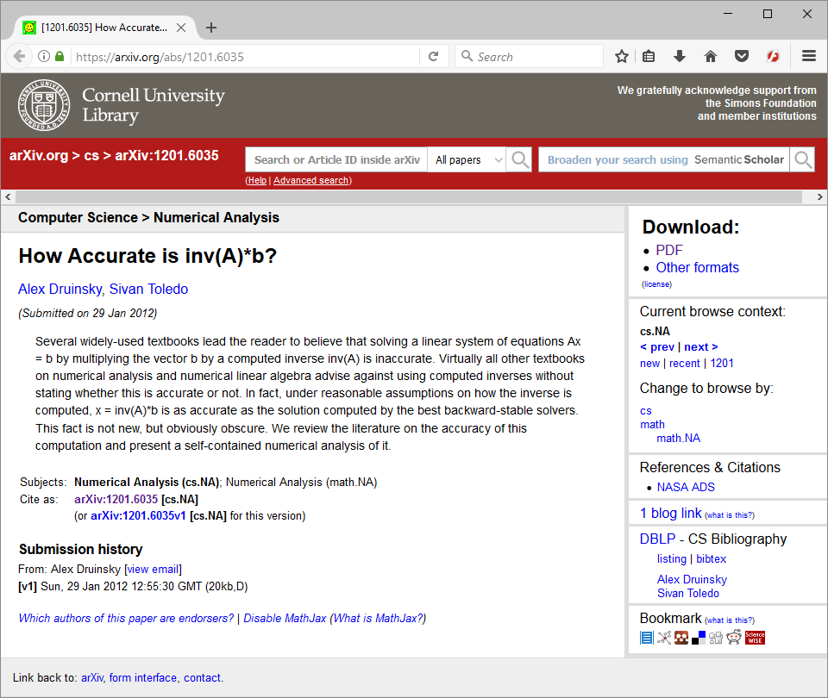
Interesting Perspective

Slide 14
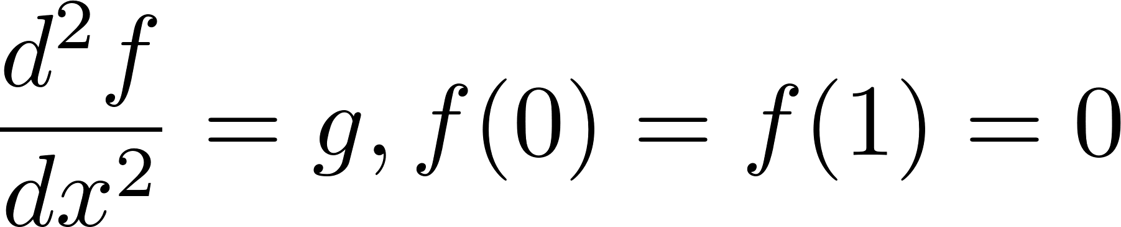
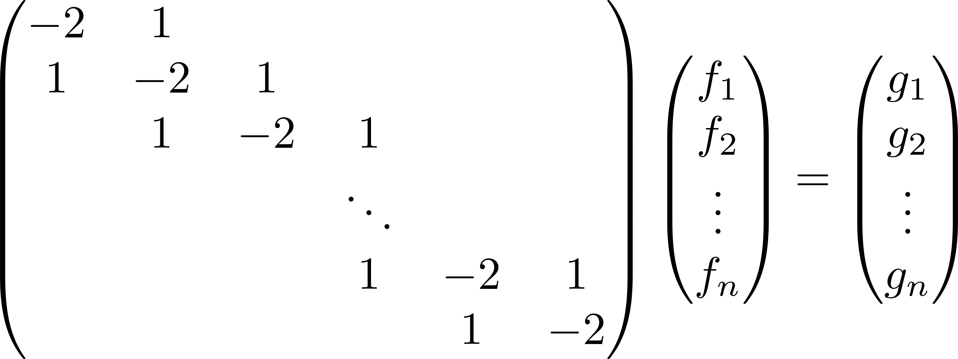
Simple Example

Slide 15
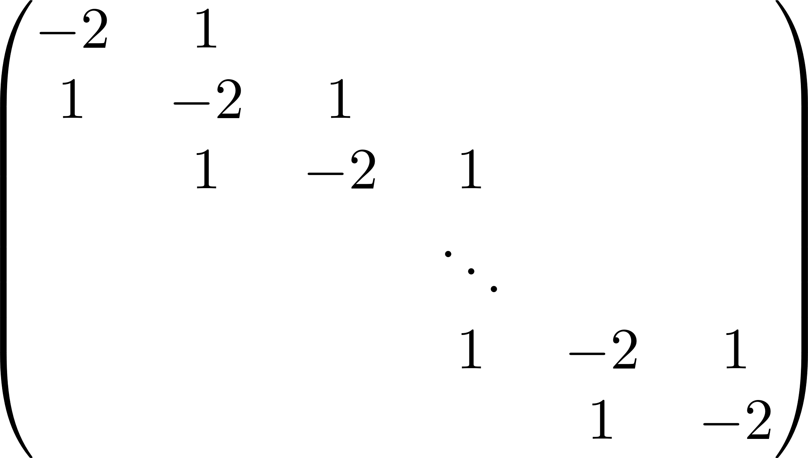
Structure?

Slide 16
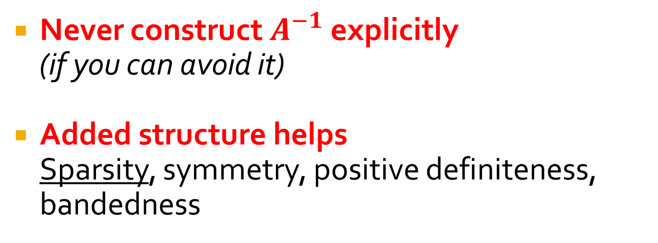
Linear Solver Considerations
Never construct $A^{−1}$ explicitly (if you can avoid it)
Added structure helps Sparsity, symmetry, positive definiteness, bandedness

Slide 17
Two Classes of Solvers
Direct (explicit matrix)
Dense: Gaussian elimination/LU, QR for least-squares
Sparse: Reordering (SuiteSparse, Eigen)
Iterative (apply matrix repeatedly)
Positive definite: Conjugate gradients
Symmetric: MINRES, GMRES
Generic: LSQR

Slide 18
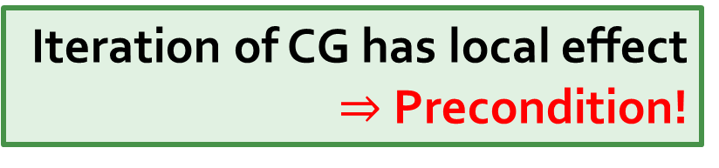
Very Common: Sparsity
Induced by the connectivity of the triangle mesh.
Iteration of CG has local effect
$⇒$ Precondition!

Slide 19
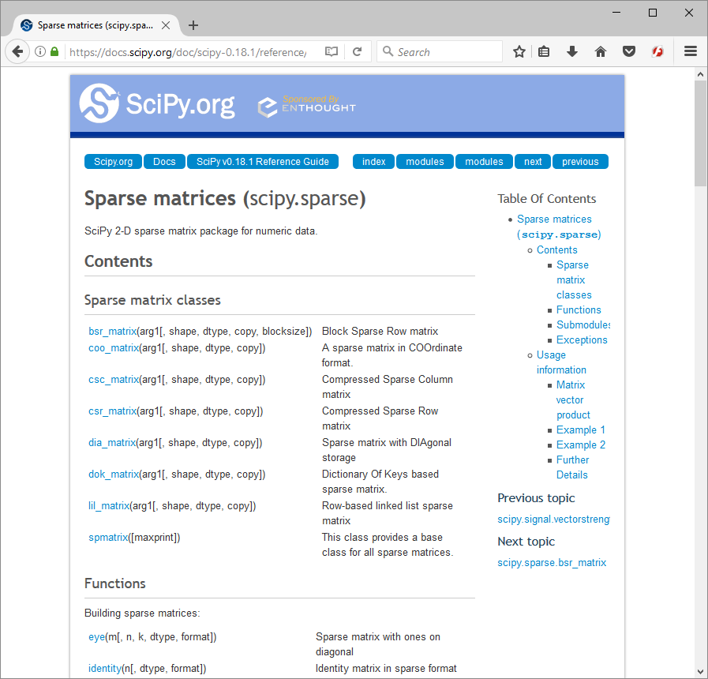
For 6.838
No need to implement a linear solver
If a matrix is sparse, your code should store it as a sparse matrix!

Slide 20
Rough Plan
Linear problems
Unconstrained optimization
Equality-constrained optimization
Variational problems

Slide 21
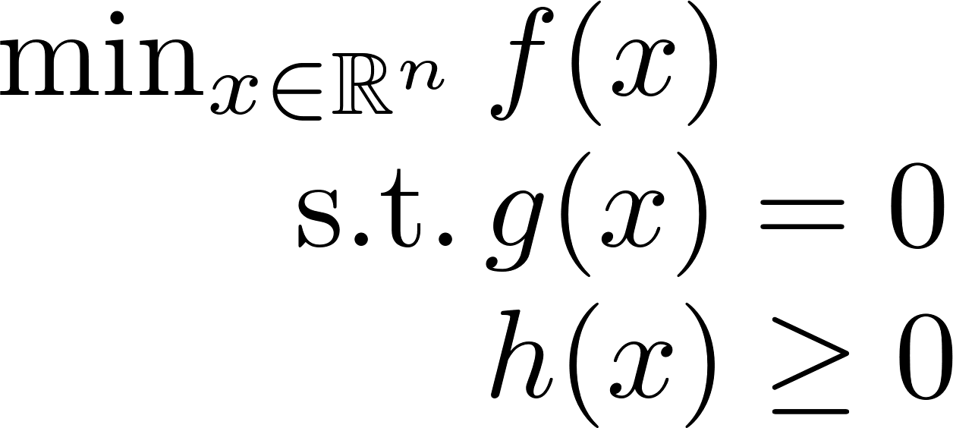
Optimization Terminology
Objective (“Energy Function”)

Slide 22
Optimization Terminology
Equality Constraints

Slide 23
Optimization Terminology
Inequality Constraints

Slide 24
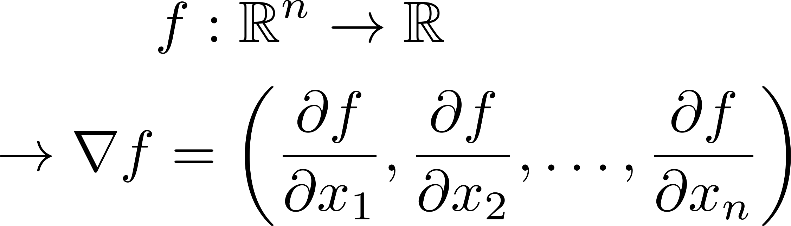
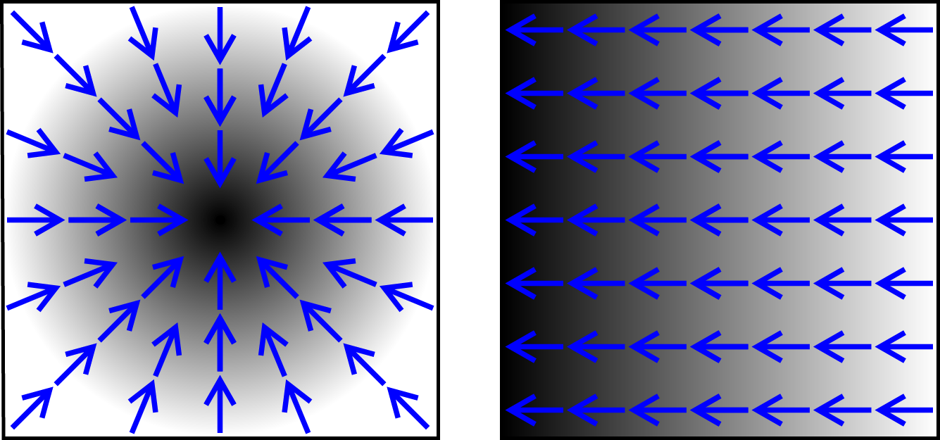
Notions from Calculus
https://en.wikipedia.org/?title=Gradient
Gradient

Slide 25
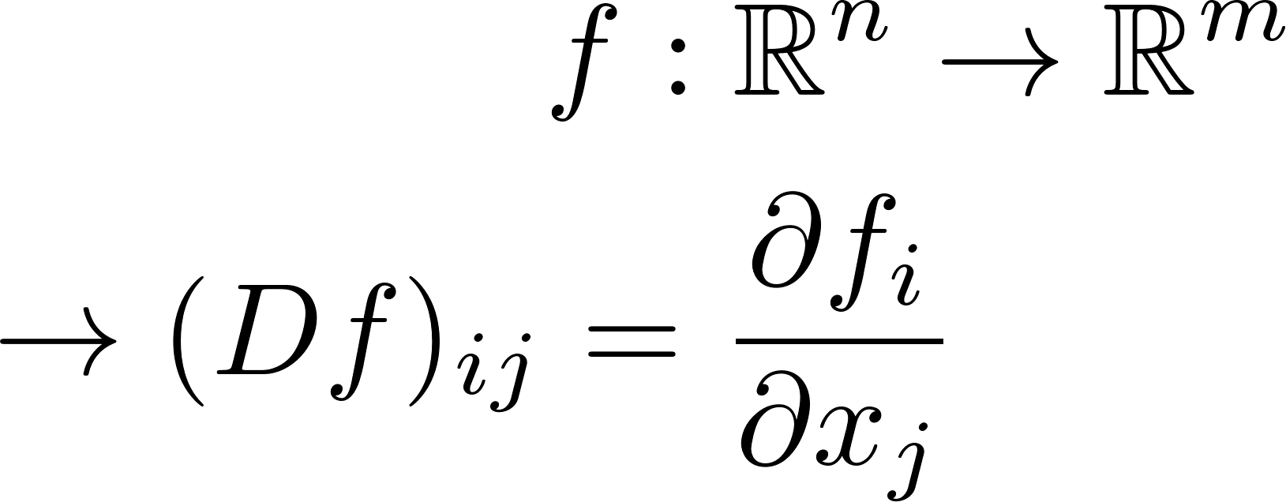
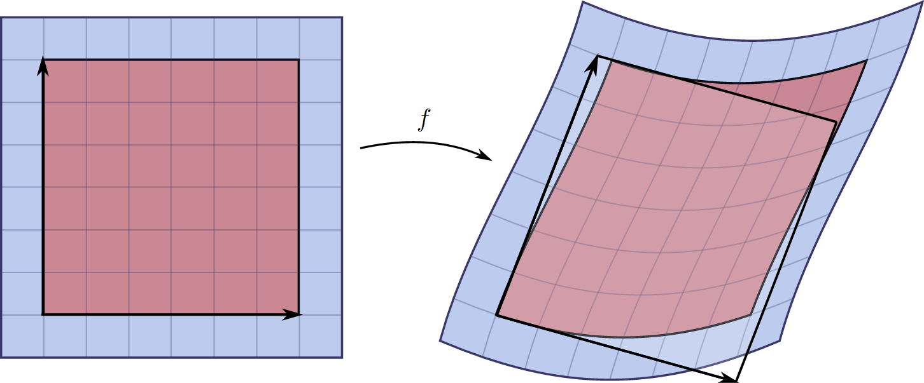
Notions from Calculus
https://en.wikipedia.org/wiki/Jacobian_matrix_and_determinant
Jacobian

Slide 26
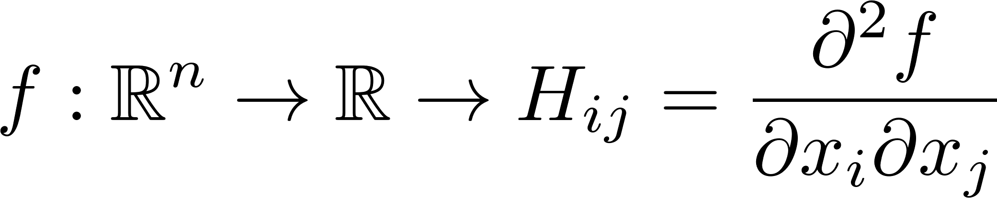
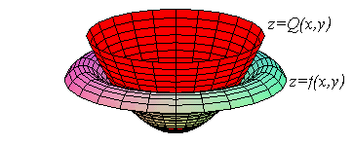
Notions from Calculus
http://math.etsu.edu/multicalc/prealpha/Chap2/Chap2-5/10-3a-t3.gif
Hessian

Slide 27
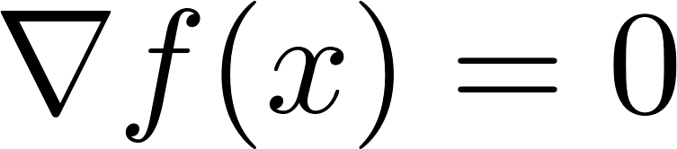
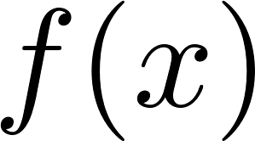

Optimization to Root-Finding
(unconstrained)
Saddle point
Local max
Local min
Critical point

Slide 28
Encapsulates Many Problems

Slide 29

How effective are generic
optimization tools?

Slide 30
How effective are generic
optimization tools?
Not very!

Slide 31
Generic Advice
Try the
simplest solver first.

Slide 32
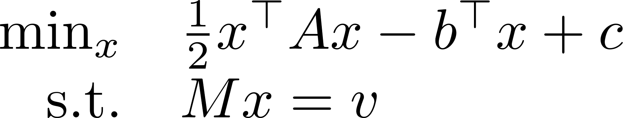
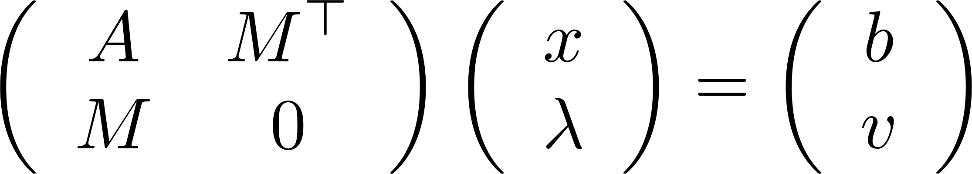
Quadratic with Linear Equality
(assume A is symmetric and positive definite)

Slide 33
Useful Document
The Matrix Cookbook
Petersen and Pedersen
http://www2.imm.dtu.dk/pubdb/views/edoc_download.php/3274/pdf/imm3274.pdf

Slide 34
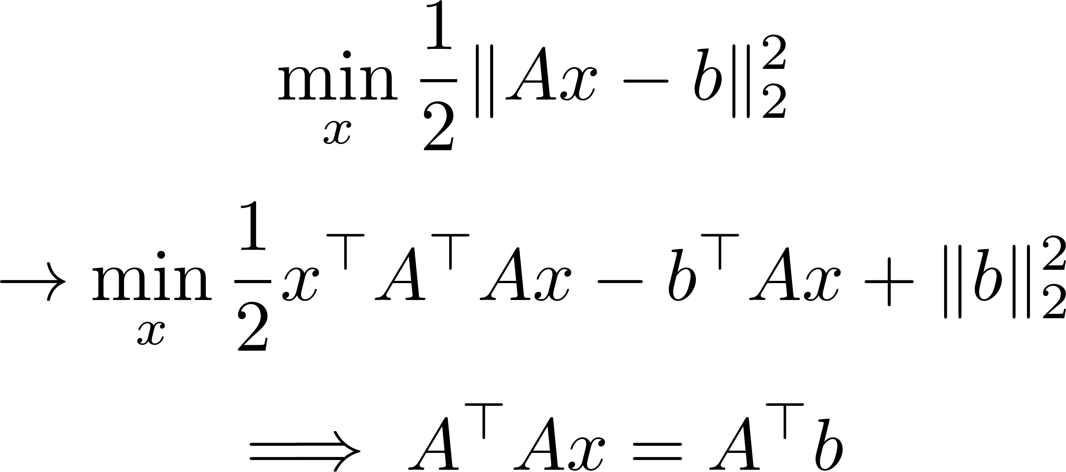
Special Case: Least-Squares
Normal equations
(better solvers for this case!)

Slide 35
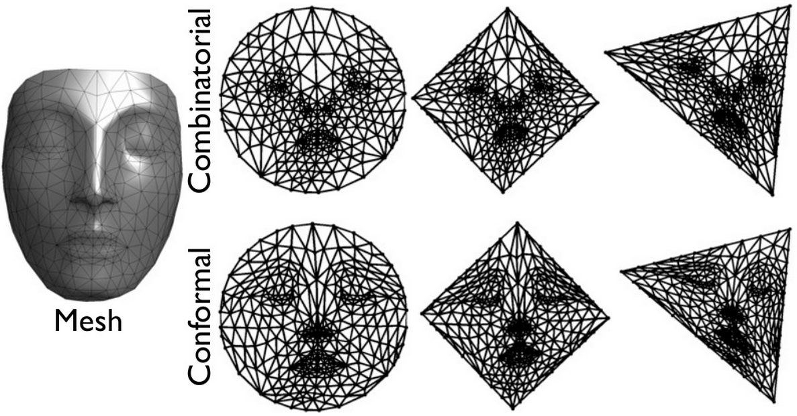
Example: Mesh Embedding
G. Peyré, mesh processing course slides

Slide 36
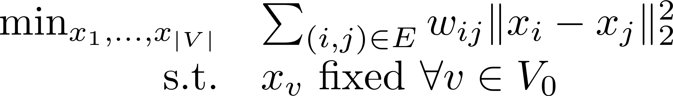
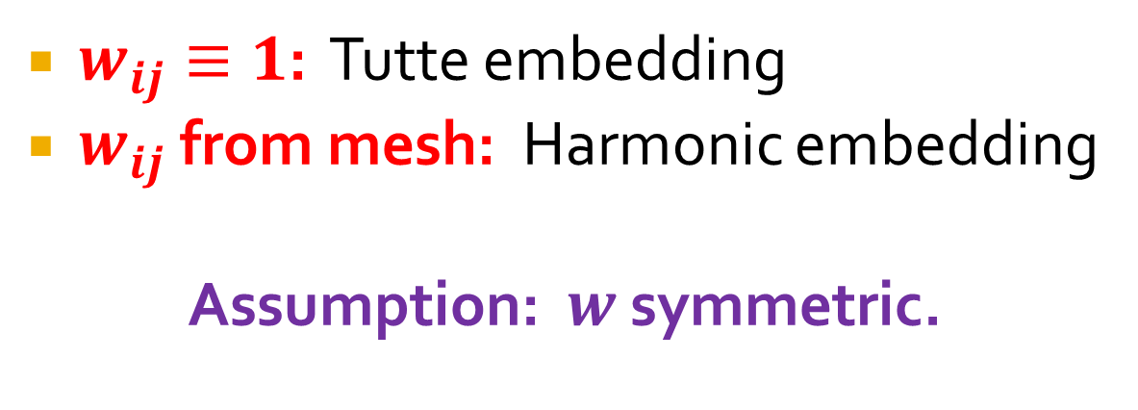
Linear Solve for Embedding
$w_{ij}≡1$: Tutte embedding
$w_{ij}$ from mesh: Harmonic embedding
Assumption: $w$ symmetric.

Slide 37
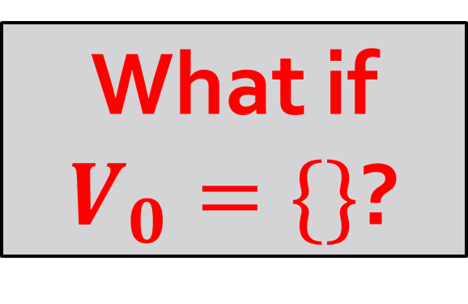
Returning to Parameterization
What if
$V_{0}=\{\}$?

Slide 38
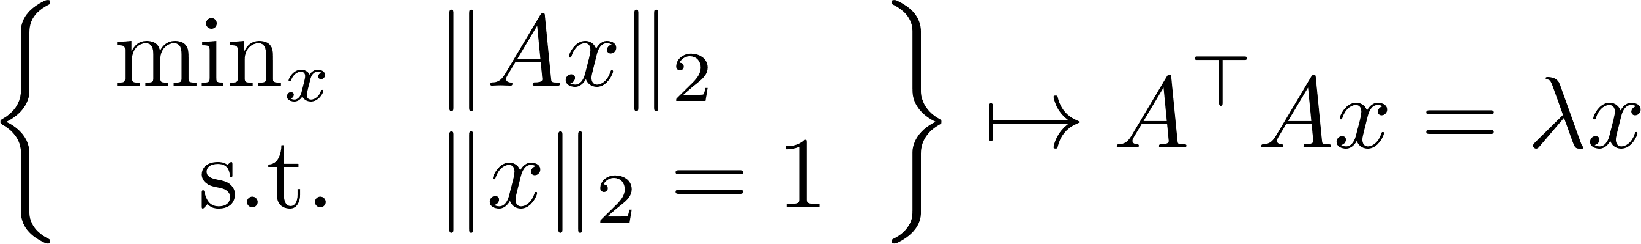
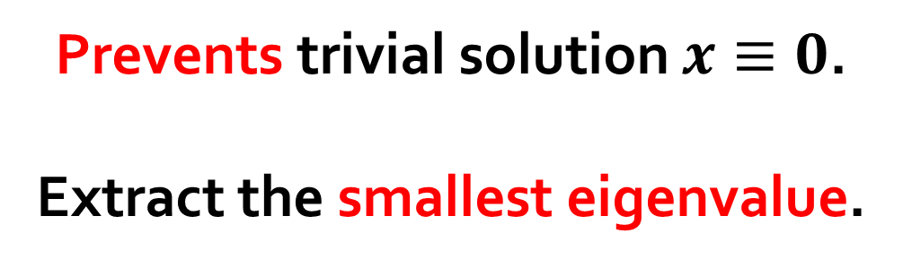
Nontriviality Constraint
Prevents trivial solution $x≡0$.
Extract the smallest eigenvalue.

Slide 39
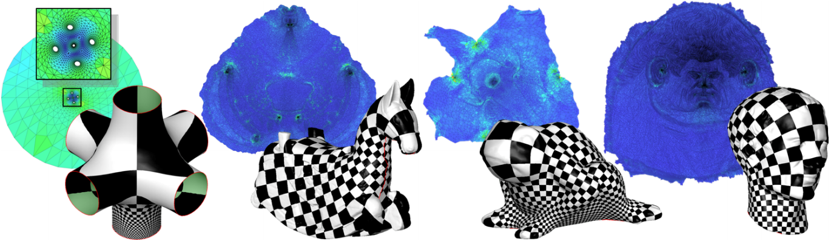
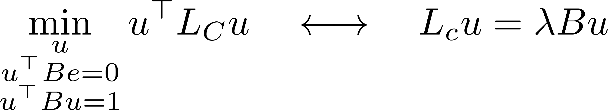
Back to Parameterization
Mullen et al. “Spectral Conformal Parameterization.” SGP 2008.
Easy fix

Slide 40
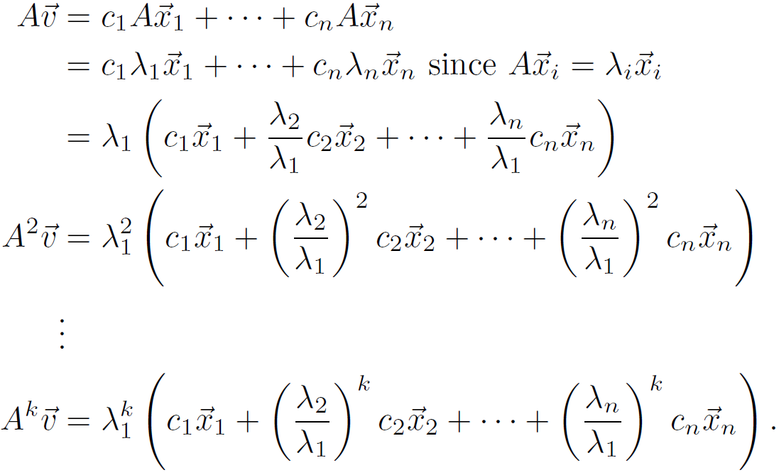
Basic Idea of Eigenalgorithms

Slide 41
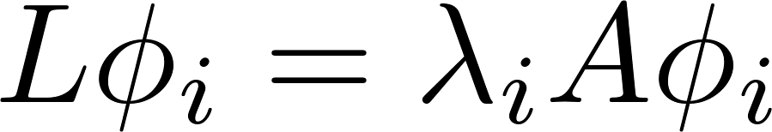
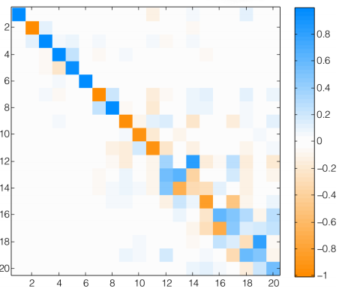
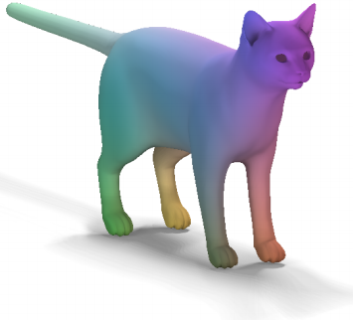
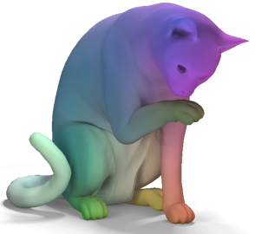
Combining Tools So Far
Roughly:
Extract Laplace-Beltrami eigenfunctions:
Find mapping matrix (linear solve!):
Ovsjanikov et al. “Functional Maps.” SIGGRAPH 2012.

Slide 42
Rough Plan
Linear problems
Unconstrained optimization
Equality-constrained optimization
Variational problems

Slide 43
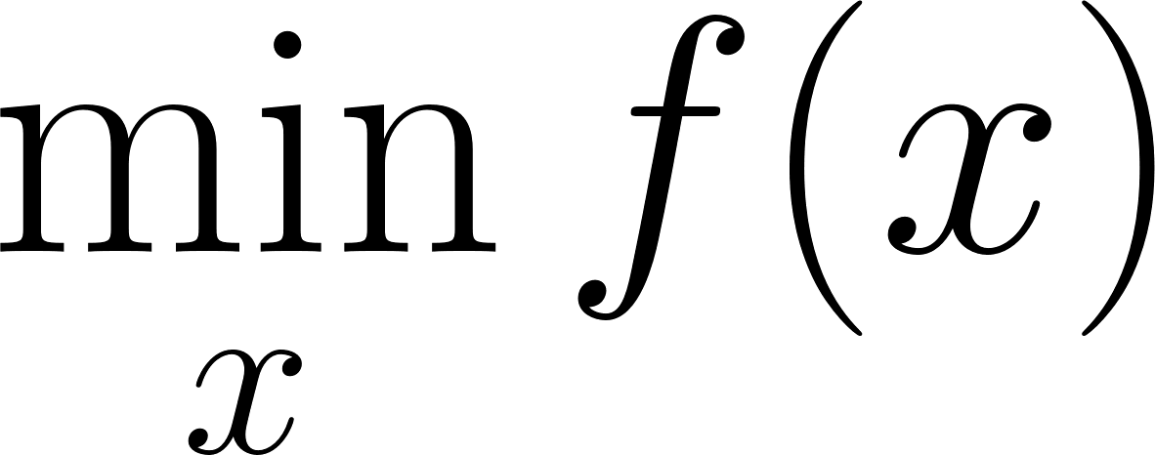
Unconstrained Optimization
Unstructured.

Slide 44

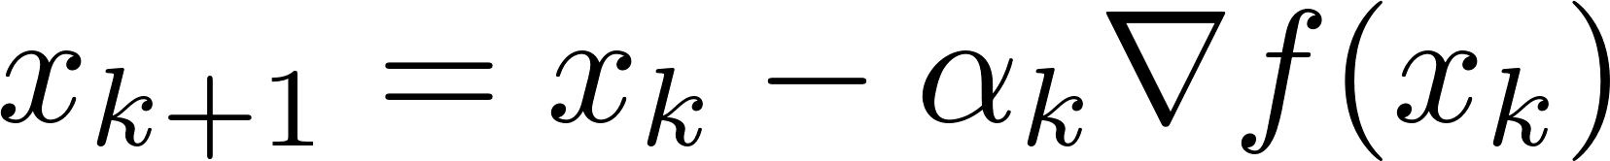
Basic Algorithms
Multiple optima!
Line search
Gradient descent

Slide 45
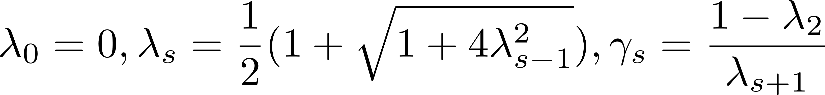
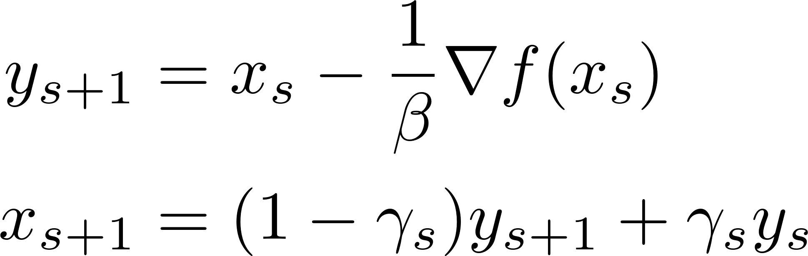
Basic Algorithms
Quadratic convergence on convex problems!
(Nesterov 1983)
Accelerated gradient descent

Slide 46
Basic Algorithms
1
2
Line search for stability
3
Newton’s Method

Slide 47
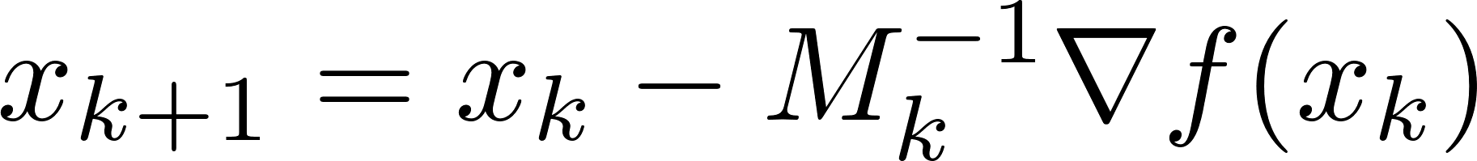
Basic Algorithms
Hessian approximation
(Often sparse) approximation from previous samples and gradients
Inverse in closed form!
Quasi-Newton: BFGS and friends

Slide 48
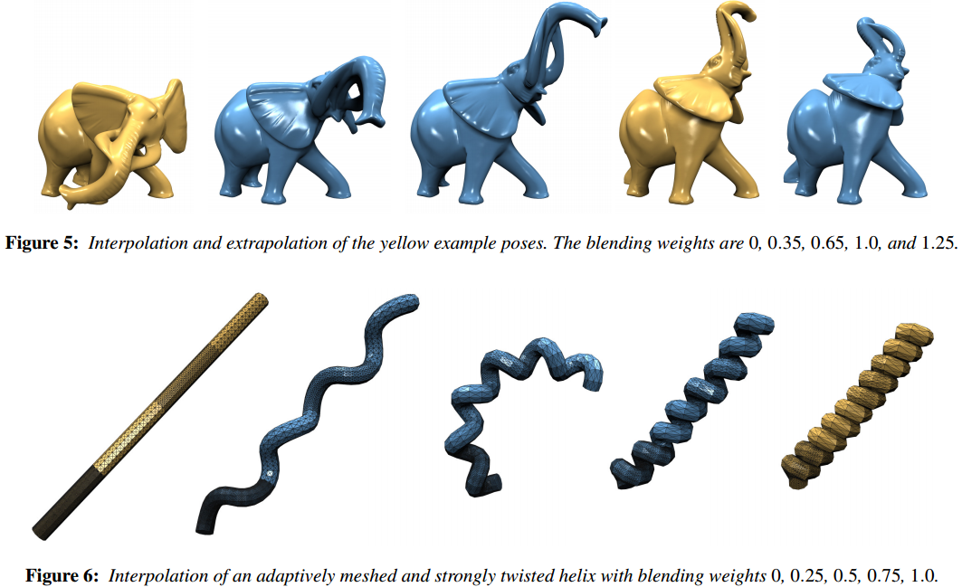
Example: Shape Interpolation
Fröhlich and Botsch. “Example-Driven Deformations Based on Discrete Shells.” CGF 2011.

Slide 49
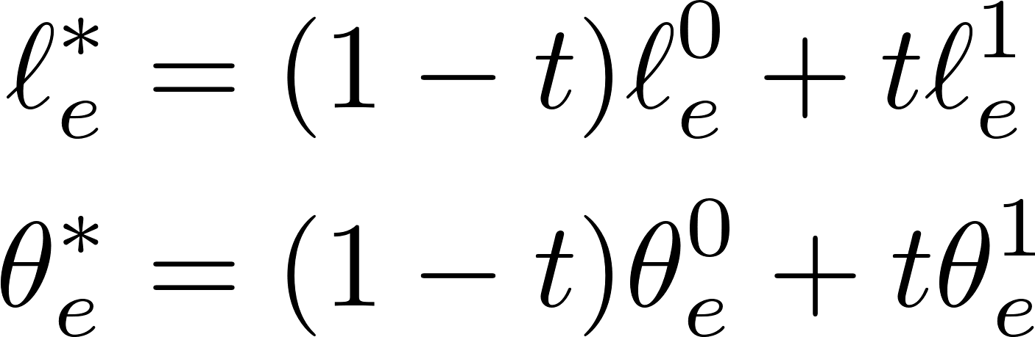
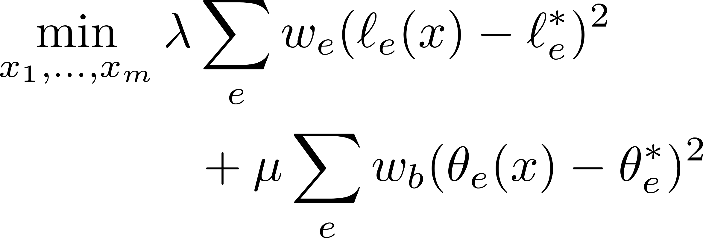
Interpolation Pipeline
Roughly:
Linearly interpolate edge lengths and dihedral angles.
Nonlinear optimization for vertex positions.
Sum of squares: Gauss-Newton

Slide 50
Software
Matlab: fminunc or minfunc
C++: libLBFGS, dlib, others
Typically provide functions for function and gradient (and optionally, Hessian).
Try several!

Slide 51
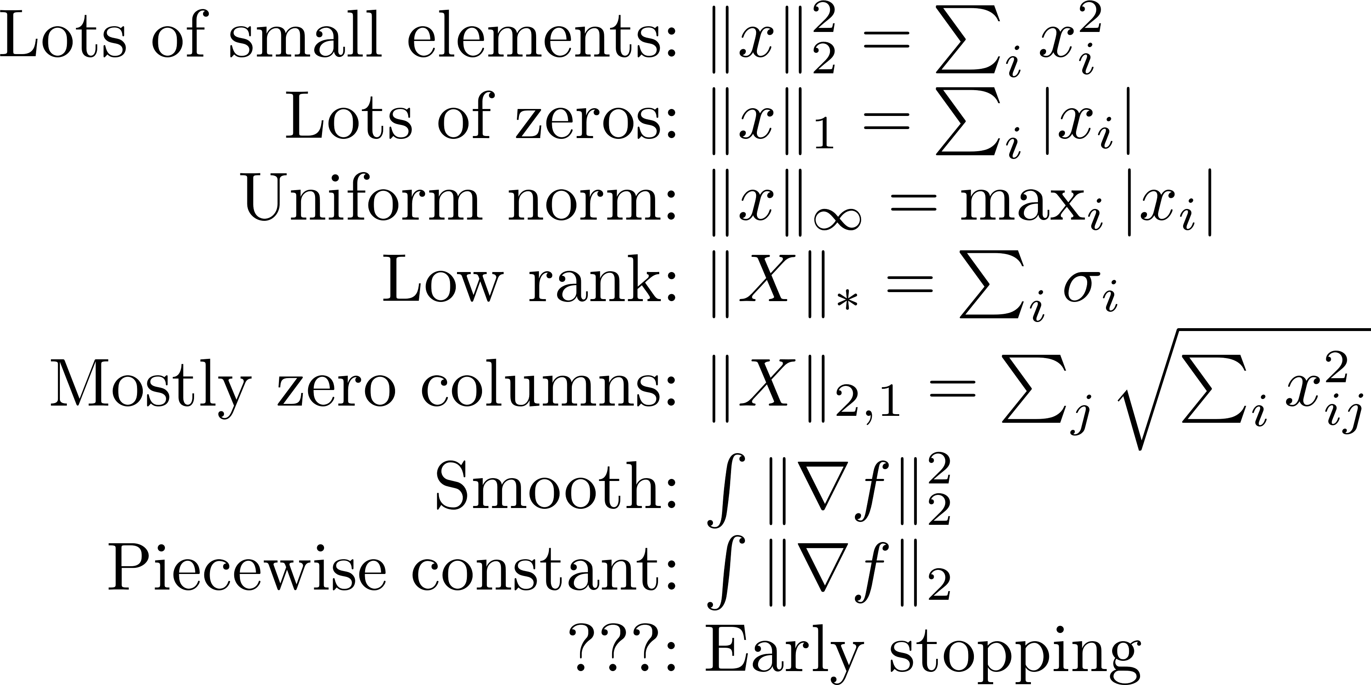
Some Tricks
Regularization

Slide 52
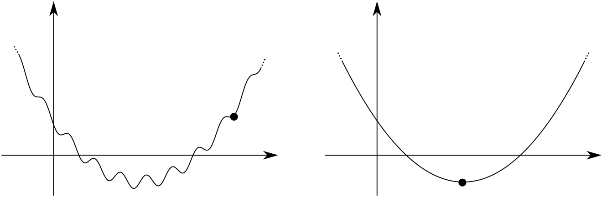
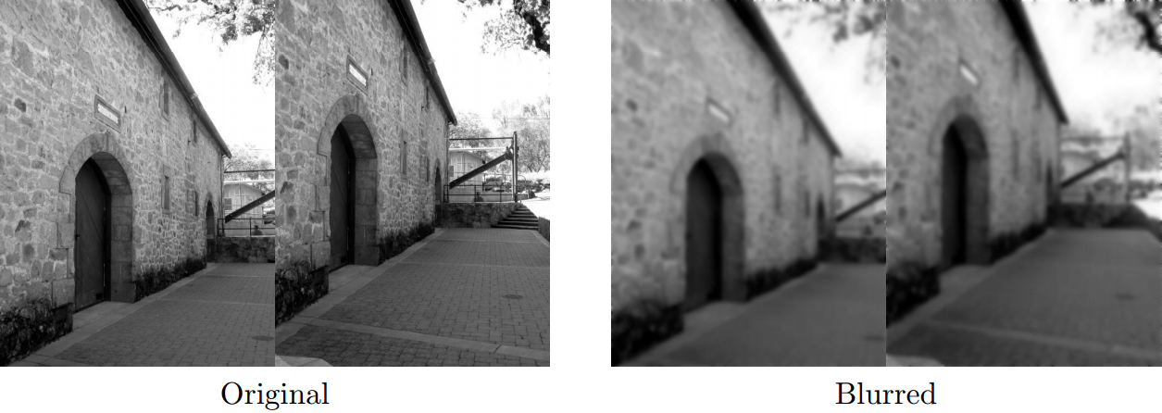
Some Tricks
Multiscale/graduated optimization

Slide 53
Rough Plan
Linear problems
Unconstrained optimization
Equality-constrained optimization
Variational problems

Slide 54



Lagrange Multipliers: Idea

Slide 55



Lagrange Multipliers: Idea
- Decrease f: $−∇f$
- Violate constraint: $±∇g$

Slide 56

Lagrange Multipliers: Idea
Want:

Slide 57

Example: Symmetric Eigenvectors

Slide 58

Use of Lagrange Multipliers
Turns constrained optimization into
unconstrained root-finding.

Slide 59

Many Options
Reparameterization Eliminate constraints to reduce to unconstrained case
Newton’s method Approximation: quadratic function with linear constraint
Penalty method Augment objective with barrier term, e.g. $f\left(x\right)+ρ|g\left(x\right)|$

Slide 60



Trust Region Methods
Fix (or adjust) damping parameter $λ>0$.
Example: Levenberg-Marquardt

Slide 61


Example: Polycube Maps
Huang et al. “L1-Based Construction of Polycube Maps from Complex Shapes.” TOG 2014.
Align with coordinate axes
Preserve area
Note: Final method includes more terms!

Slide 62


Convex Optimization Tools
Aside:
versus
Sometimes work for non-convex problems…
Try lightweight options

Slide 63


Iteratively Reweighted Least Squares
“Geometric median”
Repeatedly solve linear systems

Slide 64






Alternating Projection
d can be a Bregman divergence

Slide 65


Iterative Shrinkage-Thresholding
Decompose as sum of hard part f and easy part g.
FISTA combines with Nesterov descent!
https://blogs.princeton.edu/imabandit/2013/04/11/orf523-ista-and-fista/

Slide 66

Augmented Lagrangians
Does nothing when constraint is satisfied
Add constraint to objective

Slide 67


Alternating Direction Method of Multipliers (ADMM)
https://web.stanford.edu/~boyd/papers/pdf/admm_slides.pdf

Slide 68


The Art of ADMM “Splitting”
Augmented part
Takes some practice!
Example of “proximal” algorithm.
Solomon et al. “Earth Mover’s Distances on Discrete Surfaces.” SIGGRAPH 2014.
Want two easy subproblems

Slide 69


Frank-Wolfe
</aside>
https://en.wikipedia.org/wiki/Frank%E2%80%93Wolfe_algorithm
Linearize objective, preserve constraints

Slide 70
Rough Plan
Linear problems
Unconstrained optimization
Equality-constrained optimization
Variational problems

Slide 71
Variational Calculus: Big Idea
Sometimes your unknowns
are not numbers!
Can we use calculus to optimize anyway?

Slide 72


On the Board

Slide 73


Gâteaux Derivative
Vanishes for all ψ at a critical point!
Analog of derivative at u in ψ direction

Slide 74

Numerical Tools for Geometry
Justin Solomon MIT, Spring 2017

